Slide 1
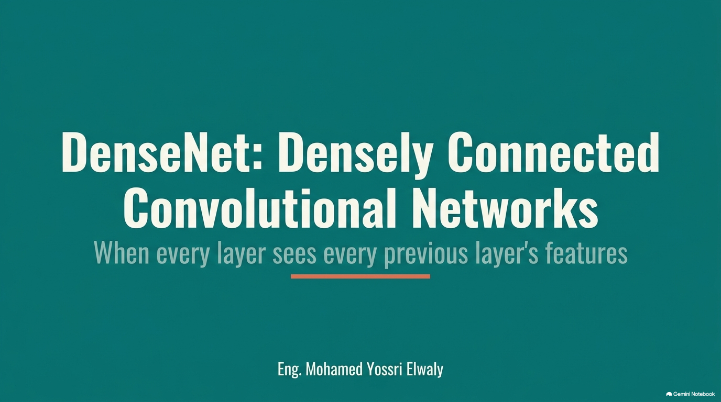

Slide 2
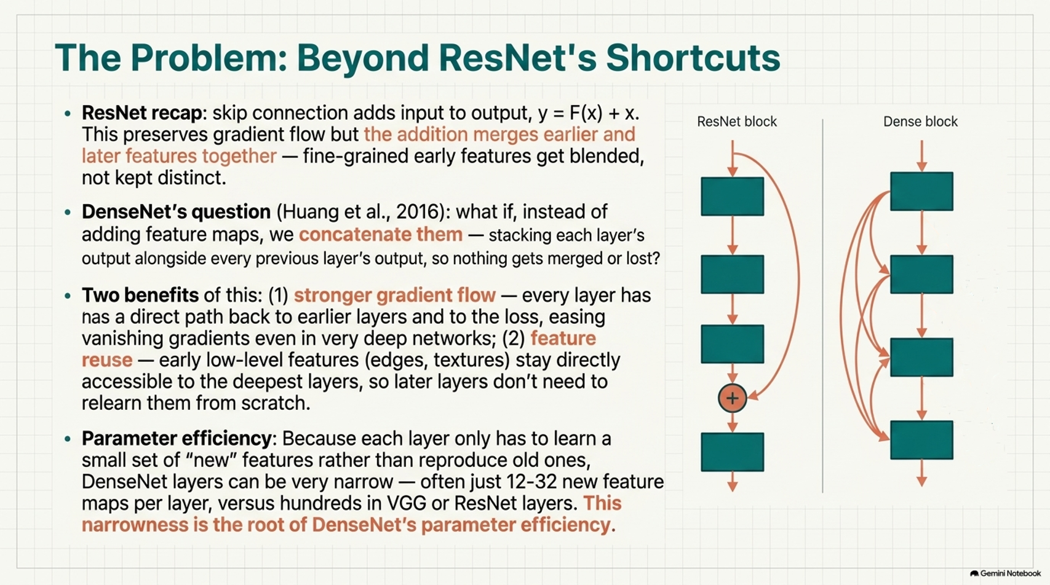
Eng. Mohamed Yossri Elwaly

Slide 3
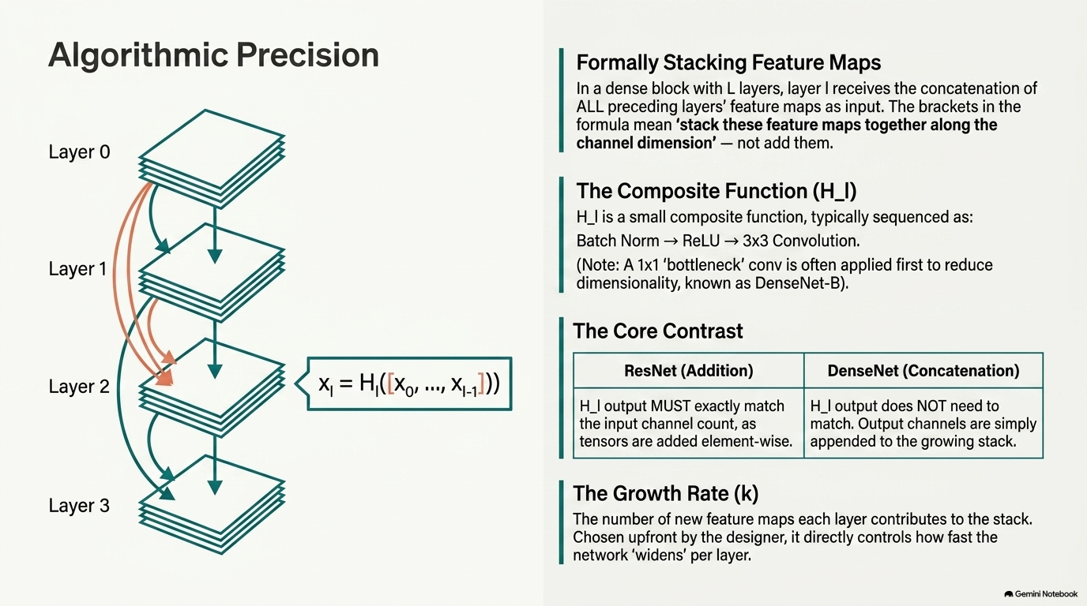
Eng. Mohamed Yossri Elwaly

Slide 4
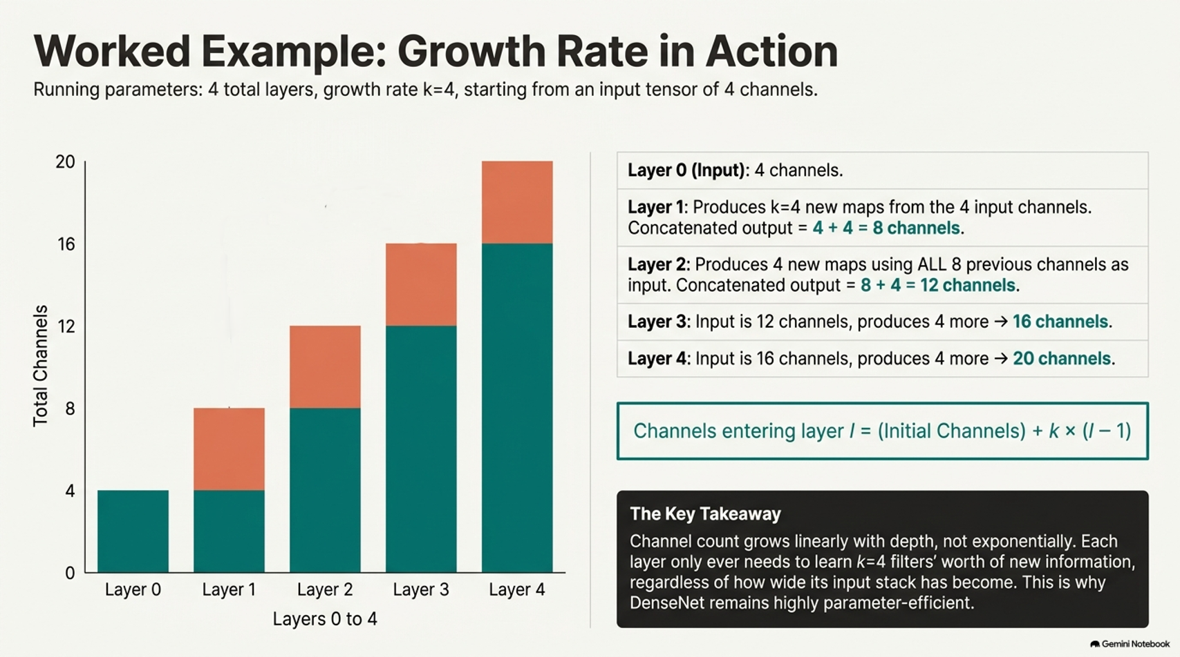
Eng. Mohamed Yossri Elwaly

Slide 5
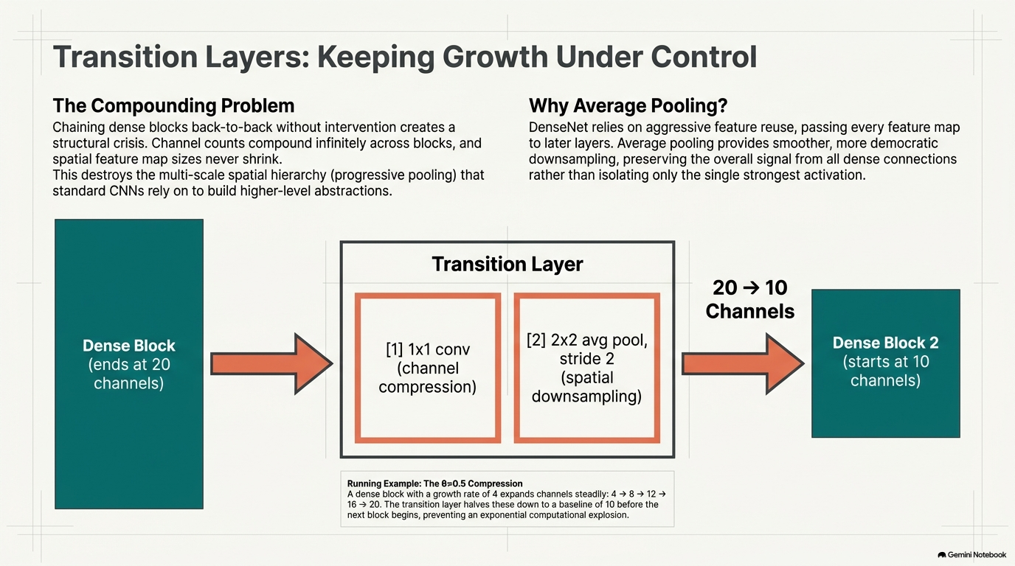
Eng. Mohamed Yossri Elwaly

Slide 6
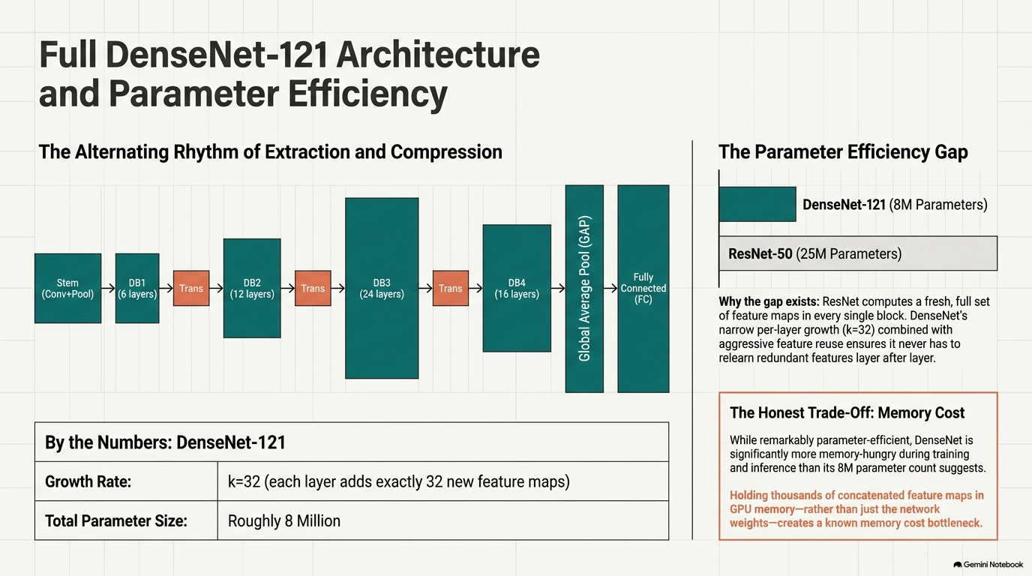
Eng. Mohamed Yossri Elwaly

Slide 7
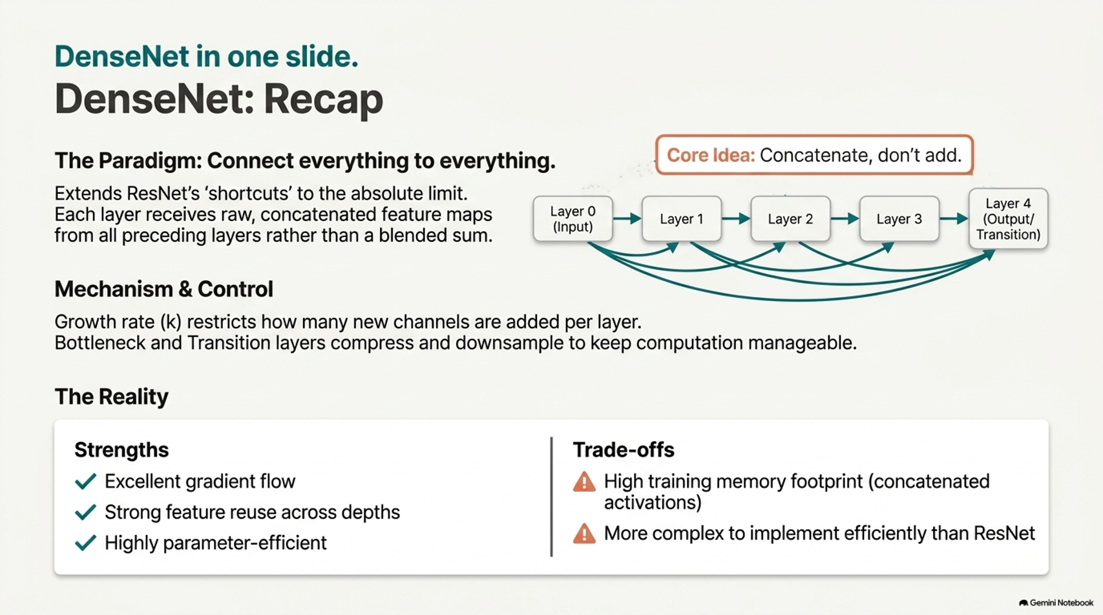
Eng. Mohamed Yossri Elwaly

